Slide 1




DB Apps Introduction
How to connect to a database natively (JDBC), Executing Statements, SQL Injection,
Advanced Concepts - Transactions, Dao Pattern
DB Apps
Introduction
SoftUni Team
Technical Trainers
Software University
http://softuni.bg

Slide 2

Table of Content
JDBC Essentials
Execute Statements
SQL Injection
Advanced Topics
Transactions
DAO Pattern

Slide 3
Questions
sli.do #db-advanced

Slide 4


JDBC Essentials

Slide 5
Java Database Connectivity (JDBC)
JDBC is a standard Java API for database-independent connectivity between the Java programming language and a wide range of databases.
The JDBC library includes APIs for each of the tasks mentioned below that are commonly associated with database usage:
Making a connection to a database.
Creating and executing SQL queries in the database.
Viewing & Modifying the resulting records.

Slide 6
JDBC Architecture
APP
JAVA.SQL.*
DRIVER
JDBC
MySQL Oracle PostgreSQL
SQL Server
RDBMS

Slide 7
Driver specifics
JDBC Connection String jdbc:<driver protocol>:<connection details>
JDBC URL
Database | JDBC URL
MySQL | jdbc:mysql://localhost
Oracle | jdbc:oracle:thin:@localhost
SQL Server | jdbc:sqlserver://localhost
PostgreSQL | jdbc:postgresql://localhost

Slide 8

Driver Download
MySQL Connector/J
https://dev.mysql.com/downloads/connector/j/

Slide 9
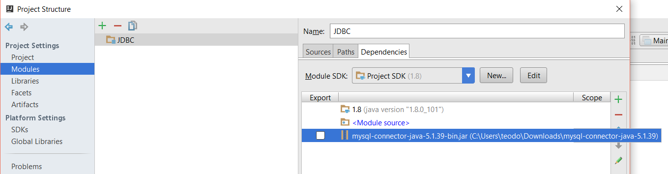
Setup Driver
IntelliJ

Slide 10
Connection Verification
package com.company;
import java.sql.*;
public class Main {
private static final String URL = "jdbc:mysql://localhost:3306/sys";
//Replace with your user name
private static final String USER = "root";
//Replace with your password
private static final String PASSWORD = "1234";
public static void main(String[] args) throws SQLException {
Connection connection = DriverManager.getConnection(URL, USER, PASSWORD);
System.out.println("The connection is successful! Well done bro!");
try {
// use the connection to execute queries. It may throw.
} finally {
try { connection.close(); } catch (SQLException e) {// log here}
}
}
}
JDBC URL
USER
PASS
Connection

Slide 11
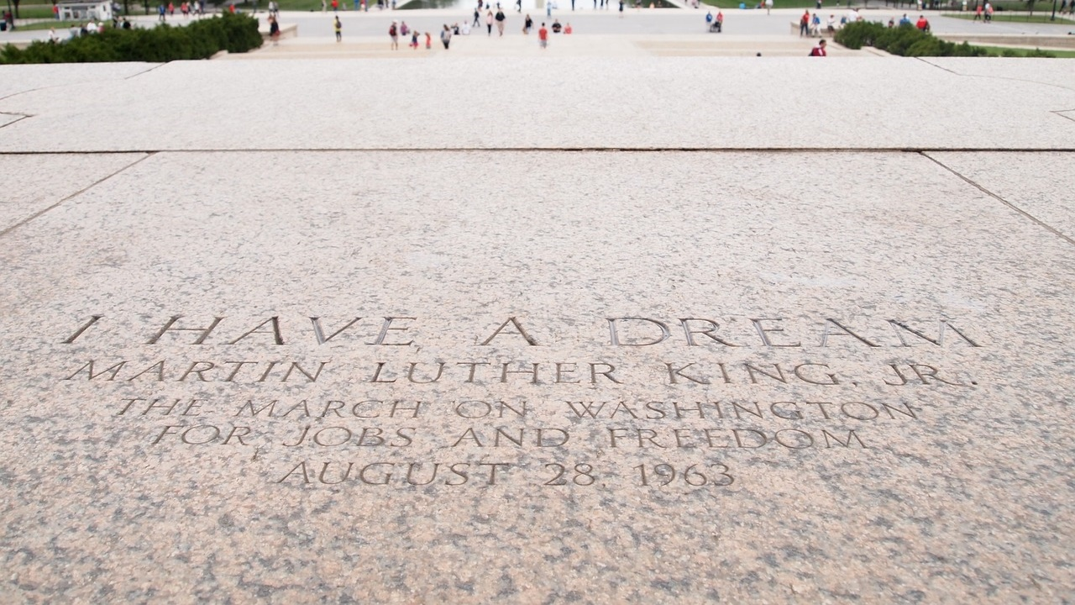
Statements

Slide 12
JDBC Components
The JDBC API provides the following interfaces and classes:
DriverManager – This class manages a list of database drivers.
Driver – This interface handles the communications with the database server.
Connection – The connection object represents communication context.
Statement – Objects used to submit the SQL statements to the database.
ResultSet – These objects hold data retrieved from a database.
SQLException – This class handles any errors that occur in a database application.

Slide 13
java.sql.*
DriverManager
Connection
Statement
ResultSet

Slide 14
Statements
Statement
PreparedStatement
CallableStatement
Interfaces | Recommended Use
Statement | Used the for general-purpose access to the database. The Statement interface cannot accept parameters.
PreparedStatement | Used when SQL statements are used many times. The PreparedStatement interface accepts input parameters at runtime.
CallableStatement | Uses when database stored procedures are called. The CallableStatement interface can also accept runtime input parameters.

Slide 15
JDBC Statement DDL Transactions
public static void main(String[] args) throws SQLException {
try (Connection connection = DriverManager.getConnection(URL, USER, PASSWORD))
{
try (Statement statement = connection.createStatement())
{
String sql = "CREATE TABLE students(" +
"id INT PRIMARY KEY," +
"name varchar(50)" +
")";
statement.executeUpdate(sql);
}
}
}
JDBC URL
Statement
SQL
Execution

Slide 16
JDBC Statement DML Transactions
public static void main(String[] args) throws SQLException {
try (Connection connection = DriverManager.getConnection(URL, USER, PASSWORD))
{
try (Statement statement = connection.createStatement())
{
String sql = "INSERT INTO students " +
"VALUES(1,'Teo')";
int affectedRows = statement.executeUpdate(sql);
System.out.println(affectedRows);
}
}
}
JDBC URL
Statement
SQL
Execution

Slide 17
ResultSet
The SQL statements (SELECT) that read data from a database query, return the data in a result set.
The java.sql.ResultSet interface represents the result set of a database query.
A ResultSet object maintains a cursor that points to the current row in the result set.

Slide 18
JDBC Statement Retrieve Data
JDBC URL
public static void main(String[] args) throws SQLException {
try (Connection connection = DriverManager.getConnection(URL, USER, PASSWORD)) {
try (Statement statement = connection.createStatement()) {
String sql = "SELECT * FROM students";
ResultSet resultSet = statement.executeQuery(sql);
while(resultSet.next()){
int id = resultSet.getInt("id");
String name = resultSet.getString("name");
System.out.println(String.format("%d, %s",id, name));
}
}
}
}
Statement
SQL
Result Set
Fetch Results

Slide 19
JDBC: SQL to Java Translation
SQL data type | Java data type
 | Simply mappable | Object mappable
CHARACTER |  | String
VARCHAR |  | String
LONGVARCHAR |  | String
NUMERIC |  | java.math.BigDecimal
DECIMAL |  | java.math.BigDecimal
BIT | boolean | Boolean
TINYINT | byte | Integer
SMALLINT | short | Integer
INTEGER | int | Integer
BIGINT | long | Long
REAL | float | Float
FLOAT | double | Double
DOUBLE PRECISION | double | Double
BINARY |  | byte[]
VARBINARY |  | byte[]
LONGVARBINARY |  | byte[]
DATE |  | java.sql.Date
TIME |  | java.sql.Time
TIMESTAMP |  | java.sql.Timestamp

Slide 20
JDBC PreparedStatement
public static void main(String[] args) throws SQLException {
try (Connection connection = DriverManager.getConnection(URL, USER, PASSWORD))
{
String sql = "SELECT * FROM students WHERE id = ?";
try (PreparedStatement preparedStatement = connection.prepareStatement(sql))
{
preparedStatement.setInt(1,1);
ResultSet resultSet = preparedStatement.executeQuery();
}
}
}
JDBC URL
SQL
Prepared Statement
Result Set

Slide 21
JDBC Parameters
SQL
String sql = "SELECT * FROM students WHERE id = ?";
//…
preparedStatement.setInt(1,1);
Parameter
Parameter Value
Position

Slide 22
JDBC CallableStatement
public static void main(String[] args) throws SQLException {
try (Connection connection = DriverManager. getConnection(URL, USER, PASSWORD))
{
String procedure = "CALL usp_update_students (?, ?)";
try (CallableStatement callableStatement = connection.prepareCall(procedure))
{
callableStatement.setInt(1, 1);
callableStatement.setString(2, "Teo");
callableStatement.execute();
}
}
}
JDBC URL
Procedure
Callable Statement
Add Parameters
Execute

Slide 23


SQL Injection
SQL Injection
How to prevent it?
What is SQL Injection and How to Prevent It?

Slide 24
What is SQL Injection?
bool login (string username, string password)
{
string sql =
"SELECT COUNT(*) FROM users " +
"WHERE username = '" + username + "' and " +
“password = '" + password + "'";
try(Statement statement = connection.createStatement()) {
ResultSet resultSet = statement.executeQuery(query);
resultSet.next();
int numberOfUsersMatched = resultSet.getInt(1);
return numberOfUsersMatched > 0; }
}
bool normalLogin =
login ("peter", "qwerty123"); // true
bool sqlInjectedLogin =
login (" ' or 1=1 #", "qwerty123"); // true
bool evilHackerCreatesNewUser = login (
“'; INSERT INTO users VALUES('hacker','') #", "qwerty123");

Slide 25
How Does SQL Injection Work?
The following SQL commands are executed:
Usual password check (no SQL injection):
SQL-injected password check:
SQL-injected INSERT command:
SELECT COUNT(*) FROM users WHERE username = 'peter' and password = 'qwerty123'
SELECT COUNT(*) FROM users WHERE username = ' ' or 1=1 #' and password = 'whatever'
SELECT COUNT(*) FROM users WHERE username = ''; INSERT INTO users VALUES('hacker','') #' and password = 'whatever'

Slide 26
Preventing SQL Injection
Ways to prevent the SQL injection:
SQL-escape all data coming from the user:
Not recommended: use as last resort only!
Preferred approach:
Use Prepared Statements
Separate the SQL command from its arguments
String escapedUsername = username.replace("'", "''");
String escapedPassword = password.replace("'", "''");
String sql =
"SELECT COUNT(*) FROM users " +
"WHERE username = '" + escapedUsername + "' AND " +
“password= '" + escapedPassword + "'";

Slide 27

Prepared Statements Prevent SQL Injection
bool login (string username, string password)
{
string sql = "SELECT COUNT(id) FROM users
WHERE username = ? and password = ?";
try (PreparedStatement statement = connection. prepareStatement(query))
statement.setString(1, username);
statement.setString(2, password);
ResultSet resultSet = statement.executeQuery();
resultSet.next();
int numberOfUsersMatched = resultSet.getInt(1);
return numberOfUsersMatched > 0;}
}
bool normalLogin = login ("peter", "qwerty123"); // true
bool sqlInjectedLogin =
login (" ' or 1=1 --", “whatever"); // false
bool evilHackerCreatesNewUser = login (
"' INSERT INTO users VALUES('hacker','') --", “whatever"); //no user created

Slide 28

Advanced Concepts

Slide 29
Transactions
public static void main(String[] args) throws SQLException{
try (Connection connection = DriverManager.getConnection(URL, USER, PASSWORD))
connection.setAutoCommit(false);
try (Statement statement = connection.createStatement()) {
String sql = "INSERT INTO students " +
"VALUES(1,'Teo')";
statement.executeUpdate(sql);
connection.commit();
} catch (SQLException e) {
connection.rollback();
}
}
}
Transaction
JDBC URL
Statement
SQL
Execute
Commit
Rollback

Slide 30
DAO Pattern
interface
StudentDao
+ getAllStudents(): List + updateStudent(): void + deleteStudent(): void + addStudent(): void
Student
id: int name: String
+ Student() + getStudentId(): int + setStudentId(): void + getStudentName(): String + setStudentName(): void
use
implements
StudentDaoImpl
students: List
+ StudentDaoImpl() + getAllStudents(): List + updateStudent(): void + deleteStudent(): void + addStudent(): void

Slide 31

Summary
JDBC Essentials
Execute Statements
SQL Injection
Advanced Topics
Transactions
DAO Pattern

Slide 32







DB Apps Introduction
https://softuni.bg/courses/databases-advanced-hibernate

Slide 33
License
This course (slides, examples, demos, videos, homework, etc.) is licensed under the "Creative Commons Attribution-NonCommercial-ShareAlike 4.0 International" license
Attribution: this work may contain portions from
"Databases" course by Telerik Academy under CC-BY-NC-SA license

Slide 34





Free Trainings @ Software University
Software University Foundation – softuni.org
Software University – High-Quality Education, Profession and Job for Software Developers
softuni.bg
Software University @ Facebook
facebook.com/SoftwareUniversity
Software University Forums
forum.softuni.bg

